Slide 1
The History of Radio Technology
Eric Zuberbuhler
6th computer science

Slide 2
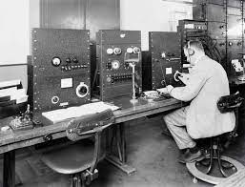
Radio owes its development to two other inventions: the telegraph and the telephone. All three technologies are closely related, and radio technology actually began as "wireless telegraphy."
The term "radio" can refer to either the electronic appliance that we listen with or to the content that plays from it. In any case, it all started with the discovery of radio waves—electromagnetic waves that have the capacity to transmit music, speech, pictures, and other data invisibly through the air. Many devices work by using electromagnetic waves, including radios, microwaves, cordless phones, remote controlled toys, televisions, and more.

Slide 3
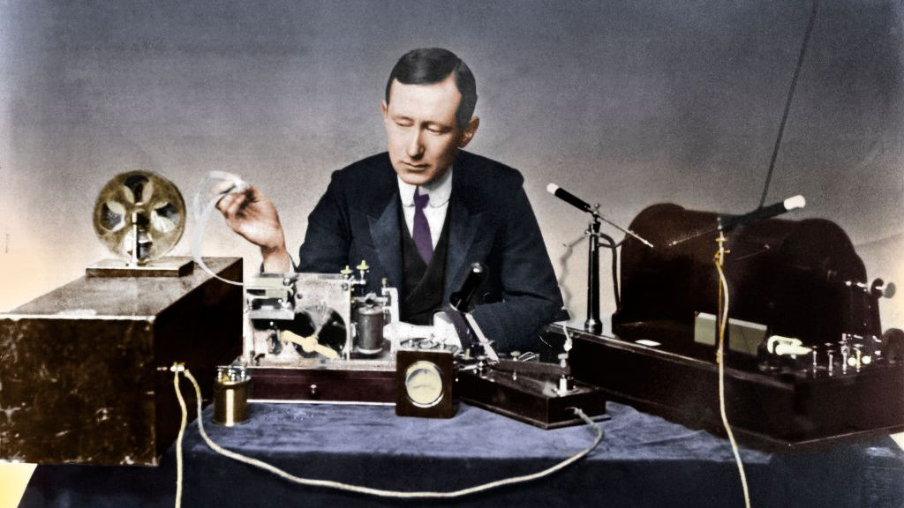
But it was Guglielmo Marconi, an Italian inventor, who proved the feasibility of radio communication. He sent and received his first radio signal in Italy in 1895. In 1899, he flashed the first wireless signal across the English Channel, and two years later received the letter "S," which was telegraphed from England to Newfoundland (now part of Canada). This was the first successful transatlantic radiotelegraph message.

Slide 4
